Slide 1
British Airways Consumer Analysis
Based on data collected at Skytrax Reviews
By Amanda Gheana

Slide 2
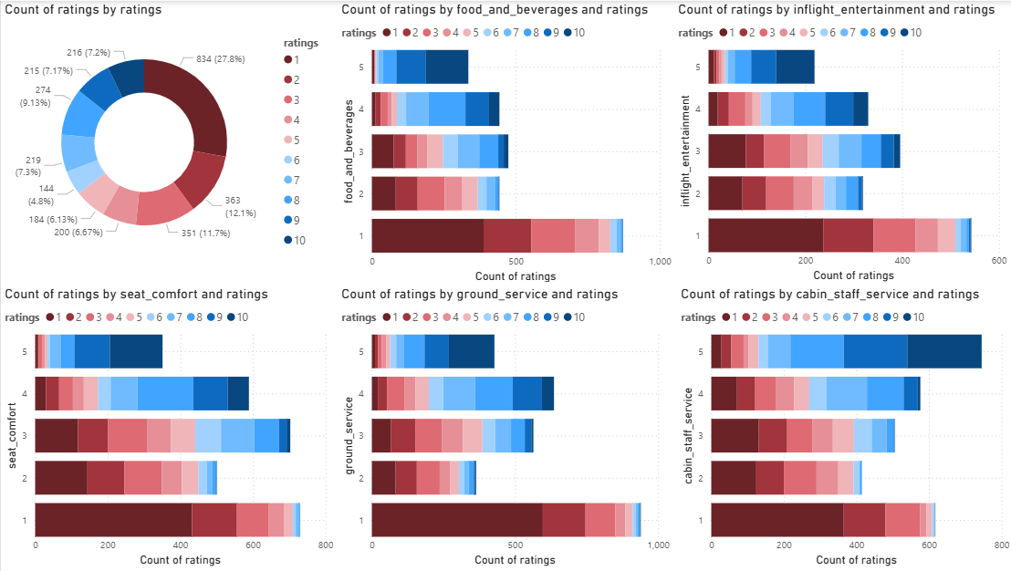
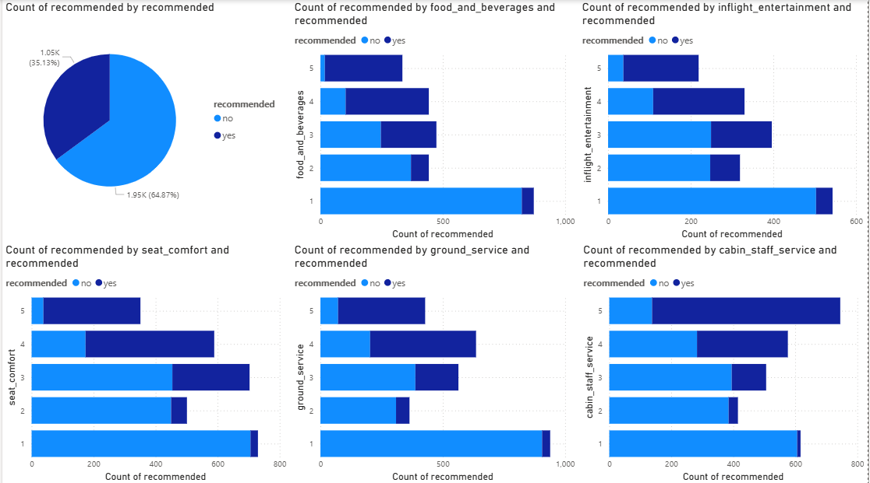
Why -1 ratings and not recommended?
The descriptive analysis shows that BA is getting low ratings and is not recommended by the passengers.
From 3000 reviews data, based on the type of ratings, which is categorised into seat comfort, food and beverages, ground services, inflight entertainment, and cabin staff services, seems like the most unlikeable service is the seat comfort of the airline and ground services, which both the ratings and the recommendations count show more than 1k complaints (got 1-2 ratings) of 3000 reviews data by the passengers.
Note that the data we collected is 90% reviews in Skytrax.

